Slide 1
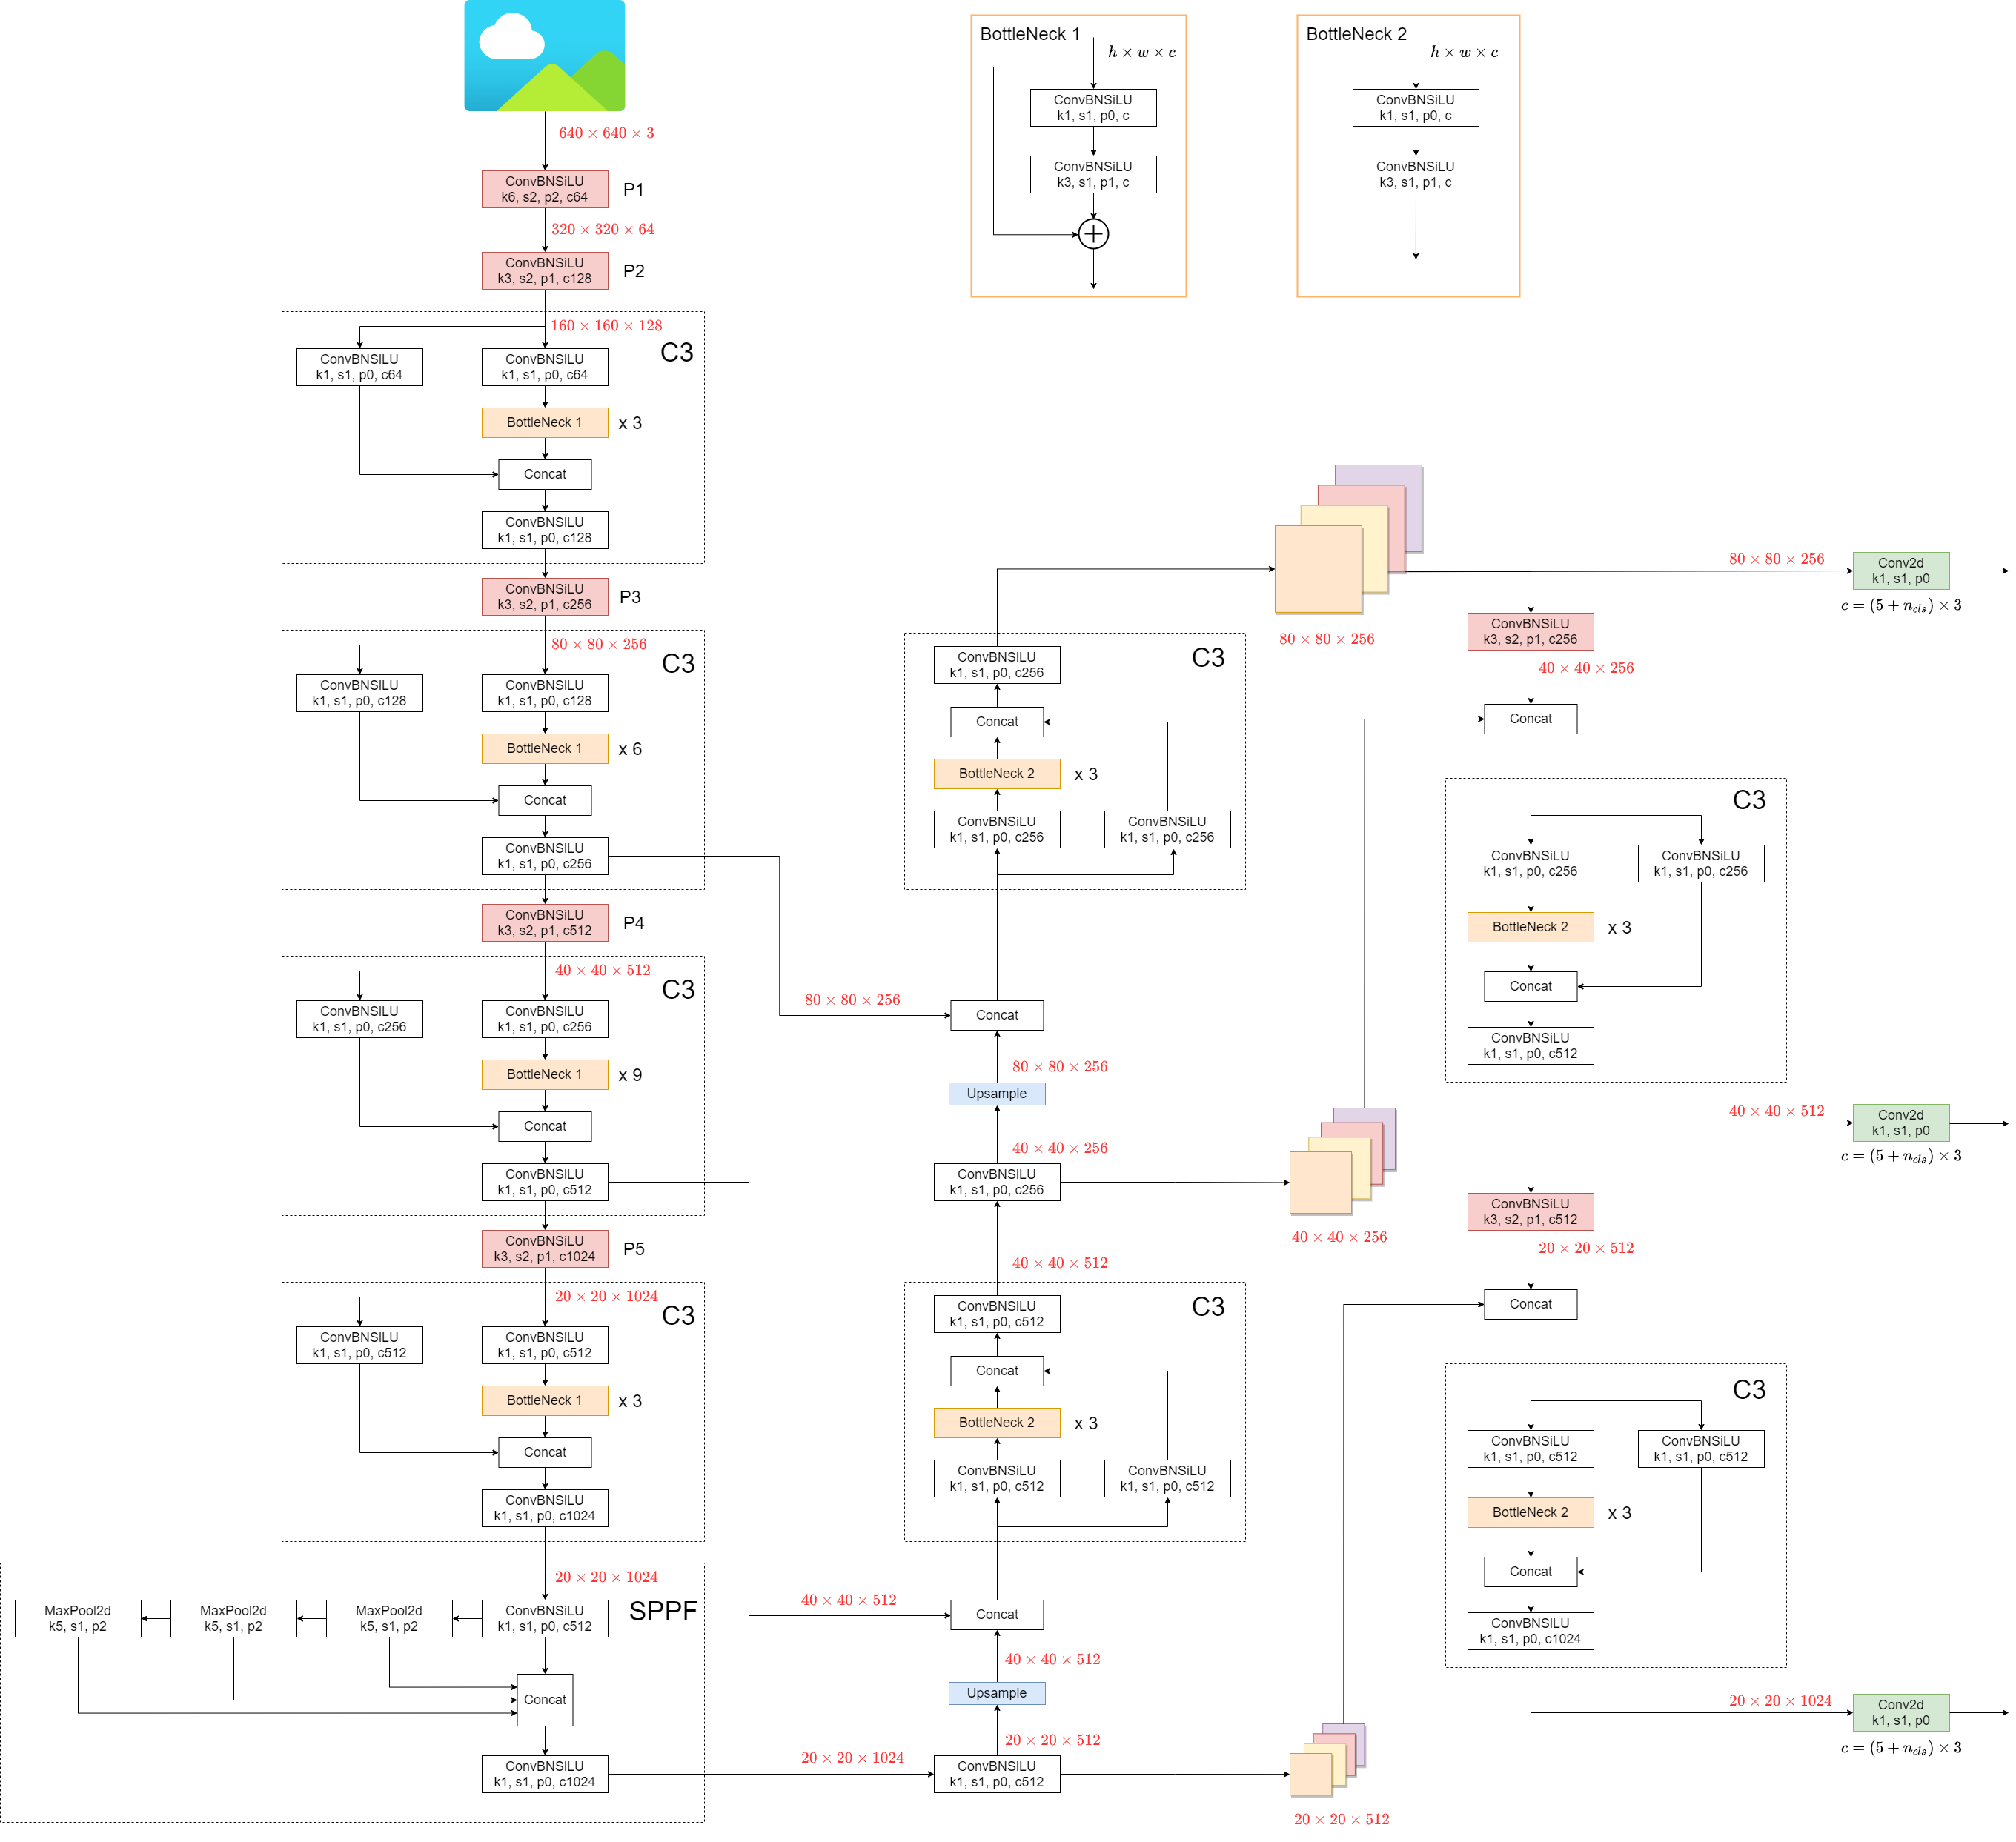
YOLOv5 architecture
- P
- BottleNeck
- C3
- SPPF

Slide 2

YOLOv5 architecture
ConvBNSiLU
Kernel_size : 1
Stride : 1
Padding : 0
Channel_out : 256
BatchNorm
SiLU activation

Slide 3
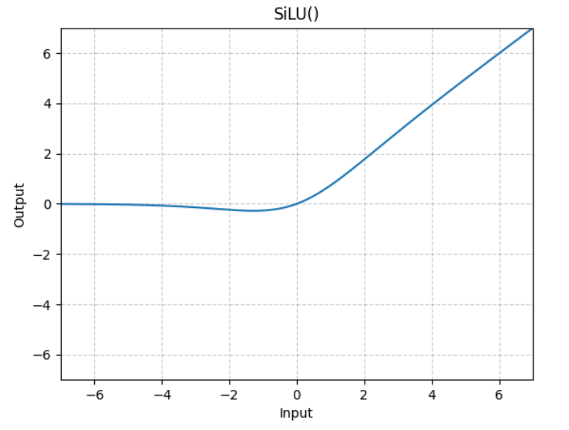

YOLOv5 architecture
SiLU activation

Slide 4
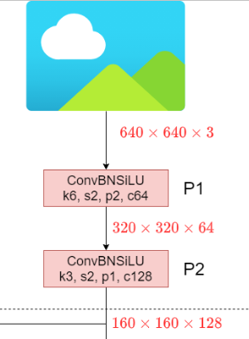
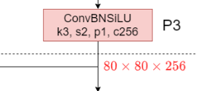
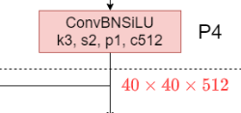
YOLOv5 architecture
P (pooling)
Red block은 Pooling으로 인해
width & height가 반으로 줄어든다.

Slide 5
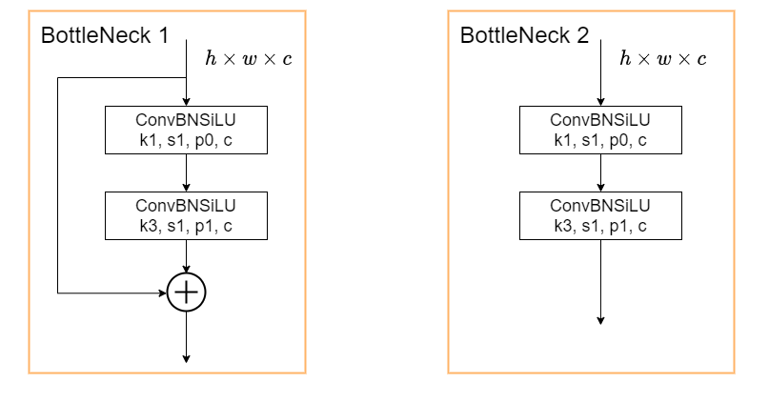
YOLOv5 architecture
BottleNeck

Slide 6
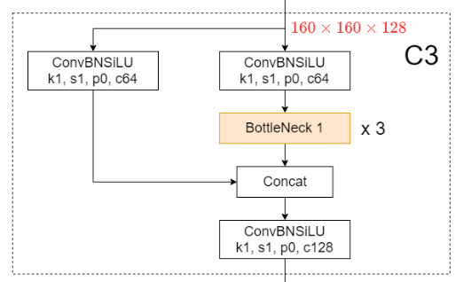
YOLOv5 architecture
C3 (connection)

Slide 7
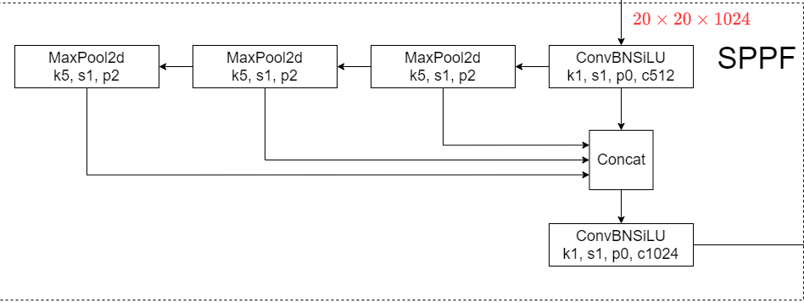
YOLOv5 architecture
SPPF (spatial pyramid pooling fast)
Receptive field를 다양하게 생성

Slide 8
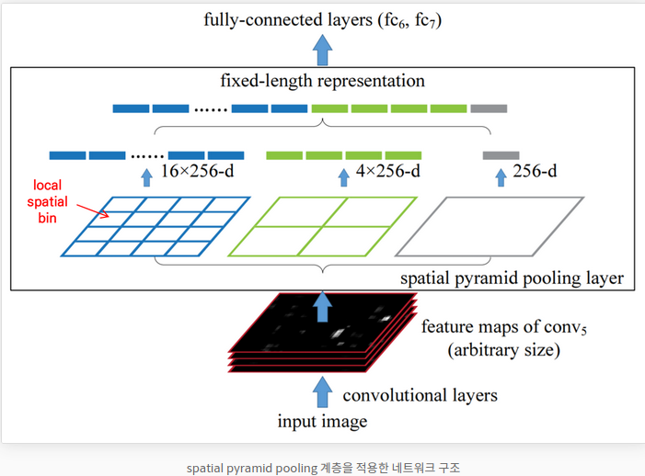
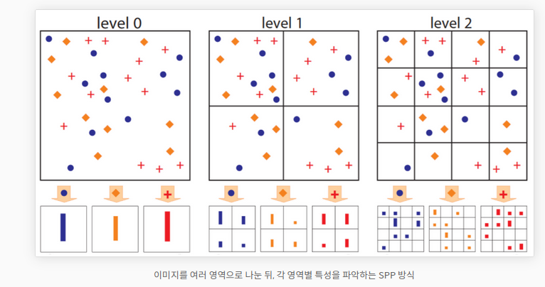
YOLOv5 architecture
SPPF (spatial pyramid pooling fast)

Slide 9
YOLOv5 architecture

